Slide 1
Syllabus of Embedded System
Unit 2: Programming for Embedded Systems (5 Hours)
2.1 Overview of AVR Architecture
2.2 Embedded C Programming for Microcontroller
Introduction to C for Embedded Systems
Data Types, Control Structures, and pointers
Memory Management
AVR Interrupt handling
Input and output ports interfacing on AVR
Timers and Counters in AVR
Serial Communication in AVR

Slide 2
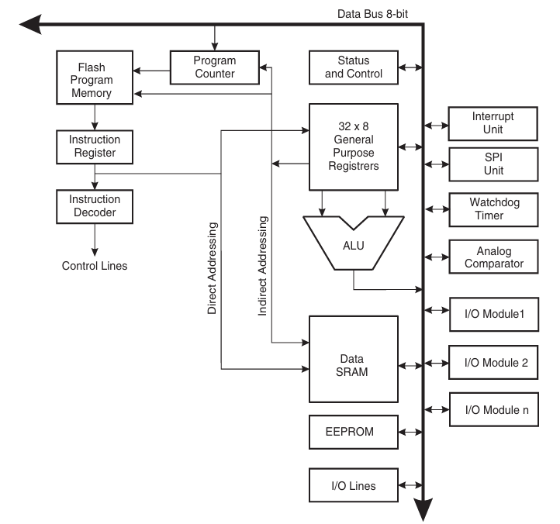
Overview of AVR Architecture
AVR is a family of 8-bit RISC microcontrollers developed by Atmel (now Microchip).
It was one of the first microcontroller families to use on-chip Flash memory for program storage.
The name AVR stands for Alf-Egil Bogen and Vegard Wollan's RISC processor.
It is based on a Harvard architecture, which separates program and data memory.

Slide 3
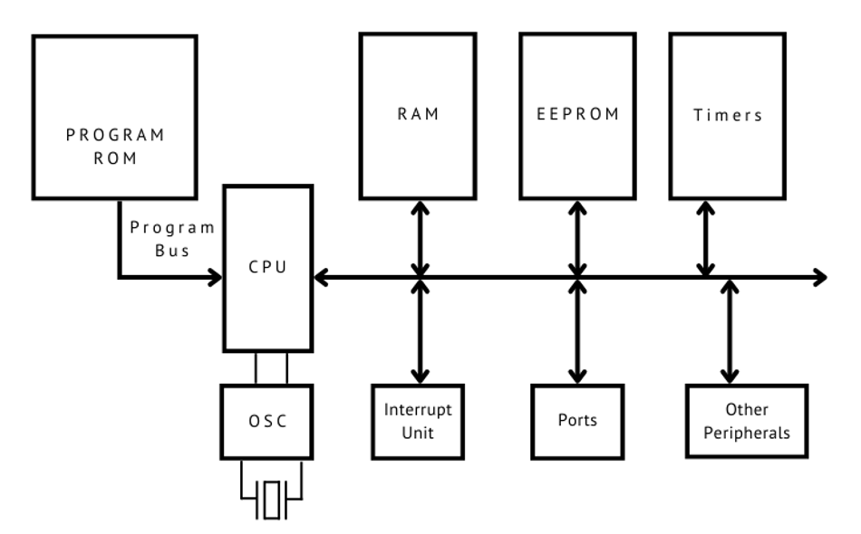
Overview of AVR Architecture

Slide 4
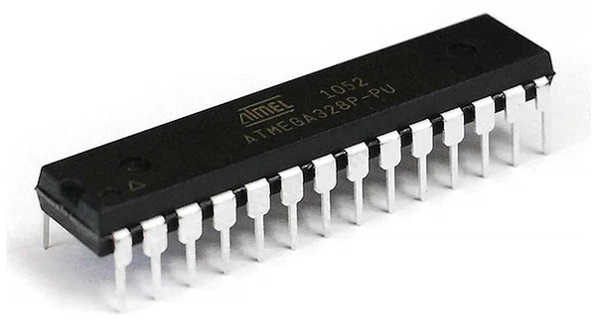
Overview of AVR Architecture
RISC Architecture: (Reduced Instruction Set Computer). Features a rich instruction set where most instructions execute in a single clock cycle.
High Performance: Achieves high throughput (approaching 1 MIPS per MHz) by executing instructions quickly and efficiently.
Modified Harvard Architecture: Uses separate buses and memories for Program (Flash) and Data (SRAM), allowing simultaneous access and improving speed.
32 General-Purpose Registers: A large register file, with all registers directly connected to the ALU (Arithmetic Logic Unit).

Slide 5





Overview of AVR Architecture
Memory Architecture
32KB Flash (Program)
2KB SRAM (Data)
1KB EEPROM (Data)
In-System Programmable (ISP) non-volatile memory used for storing the program code. It can be reprogrammed thousands of times.
Static RAM. This is volatile memory used for storing variables, stack, and data during runtime. All data is lost when power is off.
Non-volatile memory used for storing data that must be saved when power is off, such as configuration settings or calibration data.

Slide 6
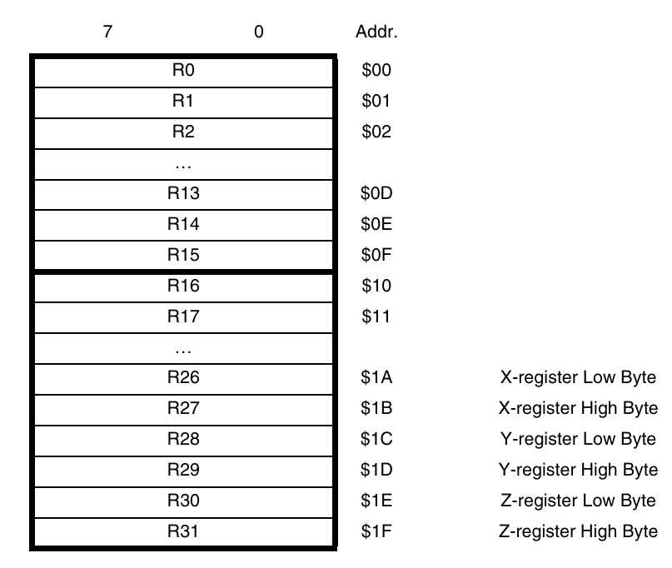
Overview of AVR Architecture
Memory Architecture
fig: 32x8 register

Slide 7
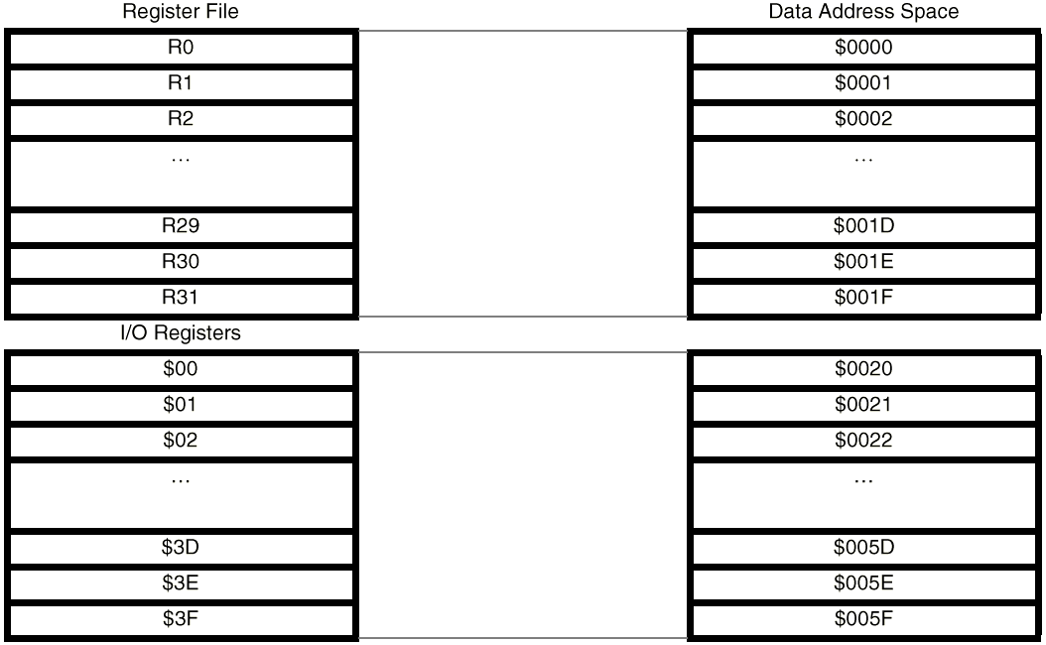
Overview of AVR Architecture
Memory Architecture

Slide 8
Overview of AVR Architecture
Memory Architecture

Slide 9


Overview of AVR Architecture
CPU and Register File
Arithmetic Logic Unit (ALU)
General Purpose Registers
The high-performance ALU is directly connected to all 32 general-purpose registers. This allows it to access two independent registers, perform an operation, and write the result back in a single clock cycle.
The 32 x 8-bit registers (R0-R31) are the heart of the AVR core. This fast-access register file is the heart of the CPU's operation, reducing the need to access the slower data SRAM.

Slide 10
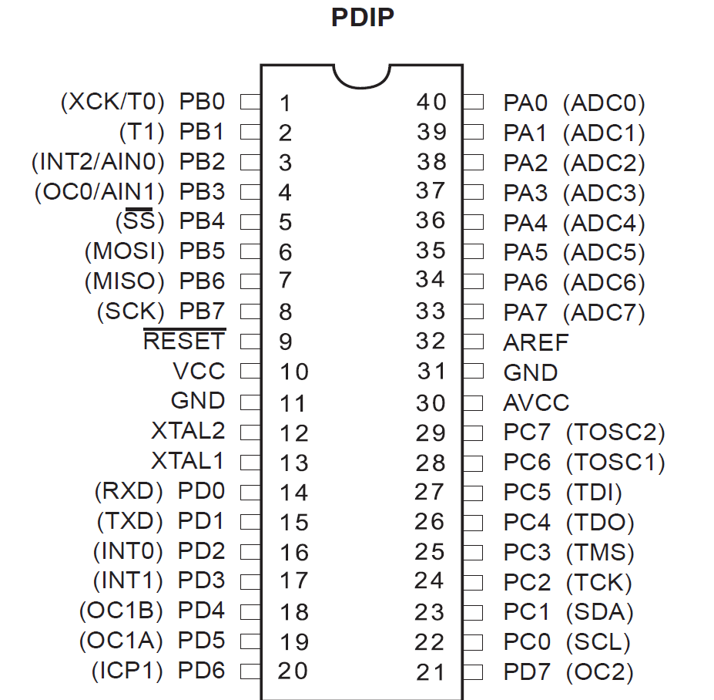
Overview of AVR Architecture
I/O ports
The ATmega32 features four 8-bit I/O ports: PORTA, PORTB, PORTC, and PORTD (totaling 32 I/O lines).
Each pin is bi-directional and can be configured as either an input or an output using three key registers:
DDRx: Data Direction Register (sets pin as input/output).
PORTx: Data Register (writes output data or enables pull-up).
PINx: Input Pins Address (reads the logic level from the pin).

Slide 11

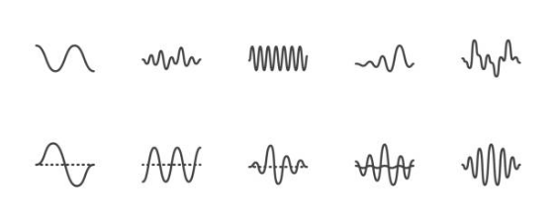
Overview of AVR Architecture
Timers and ADC
Timers/Counters: Features three timers (two 8-bit, one 16-bit). Used for timing events, generating PWM (Pulse Width Modulation), and counting external events.
Analog-to-Digital Converter (ADC): A 10-bit, 8-channel ADC. This converts real-world analog signals (like from sensors) into digital values the MCU can understand.

Slide 12





Overview of AVR Architecture
Communication System
USART
SPI
TWI (I²C)
(Universal Synchronous/Asynchronous Receiver/Transmitter) For serial communication with PCs or other devices (e.g., RS-232).
(Serial Peripheral Interface) A fast, synchronous, full-duplex communication protocol often used for high-speed peripherals like SD cards.
(Two-Wire Interface) A multi-master, multi-slave serial bus (identical to I²C) commonly used for connecting sensors and peripherals.

Slide 13
Overview of AVR Architecture
Interrupt System
Interrupts allow the MCU to respond to critical events (like a button press or data arrival) without halting the main program.
The ATmega32 has a powerful interrupt structure with multiple sources, including:
•
External Interrupts (INT0, INT1, INT2)
•
Timer Overflows/Compares
•
ADC Conversion Complete
•
USART, SPI, and TWI events

Slide 14
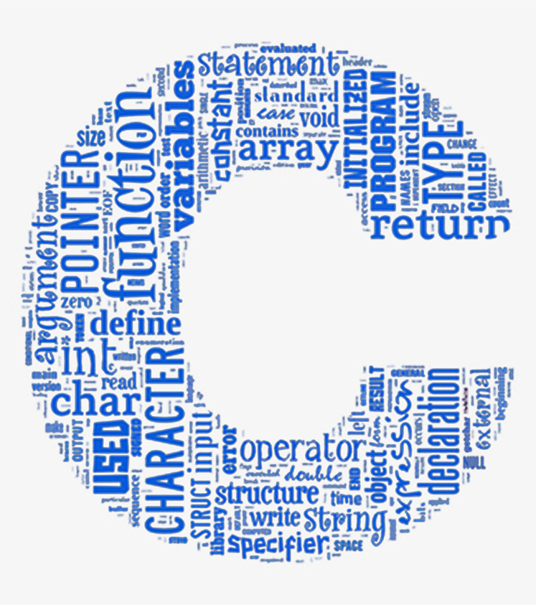
Introduction to C for embedded system
Why C for embedded systems?
Close to hardware but still high-level
Efficient and generates small, fast machine code
Full control over memory
Direct access to registers

Slide 15
Introduction to C for embedded system
No printf(), no screen, no keyboard
Everything is done through:
Registers
Peripherals
External interfaces (LEDs, sensors, serial)
No dynamic memory (avoid malloc, free)
Bad for small RAM microcontrollers.
main() never ends
There is no operating system to return to.
Timing is critical
Delays, timers, interrupts are essential.

Slide 16
Data types, Control structures and Pointers
C Type | Size on ATmega32 | Range | Notes
char | 1 byte (8-bit) | –128 to 127 | Most operations are 8-bit, very fast
unsigned char / uint8_t | 1 byte | 0 to 255 | Most common for registers
int / signed int | 2 bytes (16-bit) | –32768 to 32767 | Default integer type
unsigned int | 2 bytes | 0 to 65535 | Good for timer values
long | 4 bytes |  | Slower—avoid unless needed
float | 4 bytes |  | VERY slow on AVR, avoid in ISR & tight loops
Preferred types are uint8_t, uint16_t, uint32_t

Slide 17
Data types, Control structures and Pointers
If-else
& is ANDing and << is SHIFTing.
if (PINB & (1 << PB0)) {
PORTC |= (1 << PC0);
} else {
PORTC &= ~(1 << PC0);
}
| is ORing

Slide 18
Data types, Control structures and Pointers
switch-case
switch(mode) {
case 0: run_motor(); break;
case 1: stop_motor(); break;
case 2: reverse_motor(); break;
}
Used in
Finite state machine
Menu systems

Slide 19
Data types, Control structures and Pointers
while(1)
while (1) {
read_sensor();
update_output();
}
while(1) is the backbone of main()

Slide 20
Data types, Control structures and Pointers
for loops
for (uint8_t i = 0; i < 8; i++) {
PORTA = (1 << i);
_delay_ms(200);
}
Used for
Short delays
Repetitive GPIO patterns

Slide 21
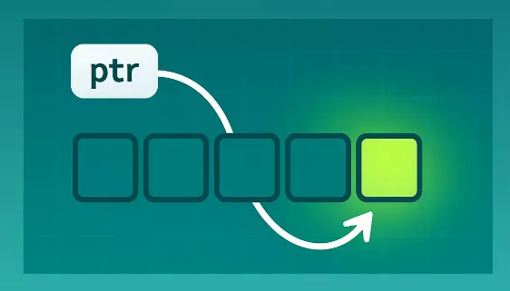
Data types, Control structures and Pointers
pointers
A pointer in C is a variable that stores the address of another variable.

Slide 22
Data types, Control structures and Pointers
pointers
Use of pointers
Access hardware registers directly
Manipulate port registers dynamically
Pass variables to functions by reference
uint8_t x = 10;
uint8_t *ptr = &x;

Slide 23
Data types, Control structures and Pointers
Registers are memory addresses that control hardware.
DDRC |= (1 << PC0); // Set PC0 as output
PORTC &= ~(1 << PC0); // Set PC0 LOW
avr/io.h defines all register name like PORTA, DDRA, PINA, etc
|= , &=~ are used to set/clear bits.

Slide 24
Data types, Control structures and Pointers
volatile
Use volatile when:
Variable is a hardware register
Variable is modified by an interrupt
Variable is changed by hardware (ADC, Timer, UART)
Variable is shared between main code and ISR
Variable might change without your program writing to it
volatile uint8_t *portA = (uint8_t*)0x1B;
*portA = 0xFF; // Write to PORTA

Slide 25
Data types, Control structures and Pointers
#include <avr/io.h>
int main(void) {
DDRA = 0xFF; // Configure PORTA as output
PORTA = 0b10101010; // Output pattern
while (1) {
// Endless loop
}
}
#include <avr/io.h> : Gives access to all Atmega registers
main(): program starts here
while(1): program starts here

Slide 26
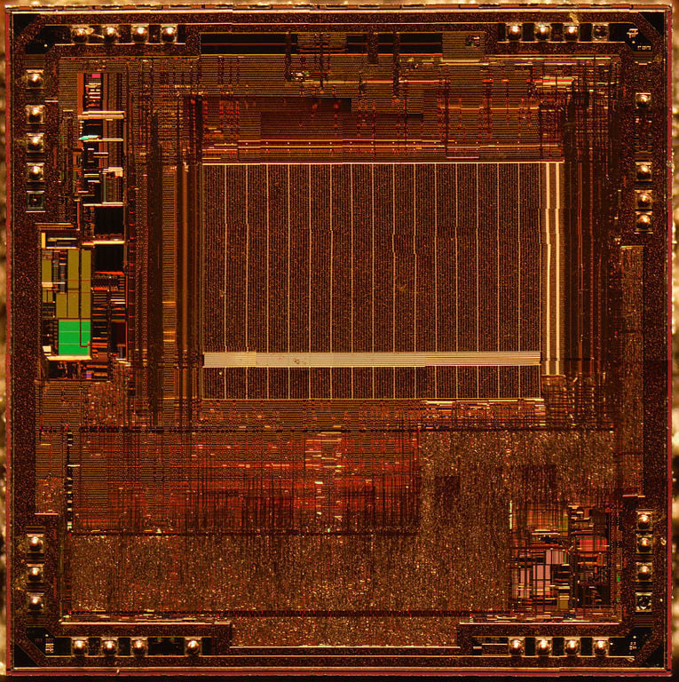
Memory management
Flash Memory Management
Flash memory is read-only during normal operation and is used to store the program code.
Use compiler optimization settings (e.g., -Os in GCC) to reduce code size.
Store constant data (e.g., lookup tables, strings) in flash using the PROGMEM directive.
Avoid frequent flash rewrites as they have limited write cycles.
Use bootloaders to simplify firmware updates without external programming tools.
Utilize segment analysis tools to track flash usage.

Slide 27
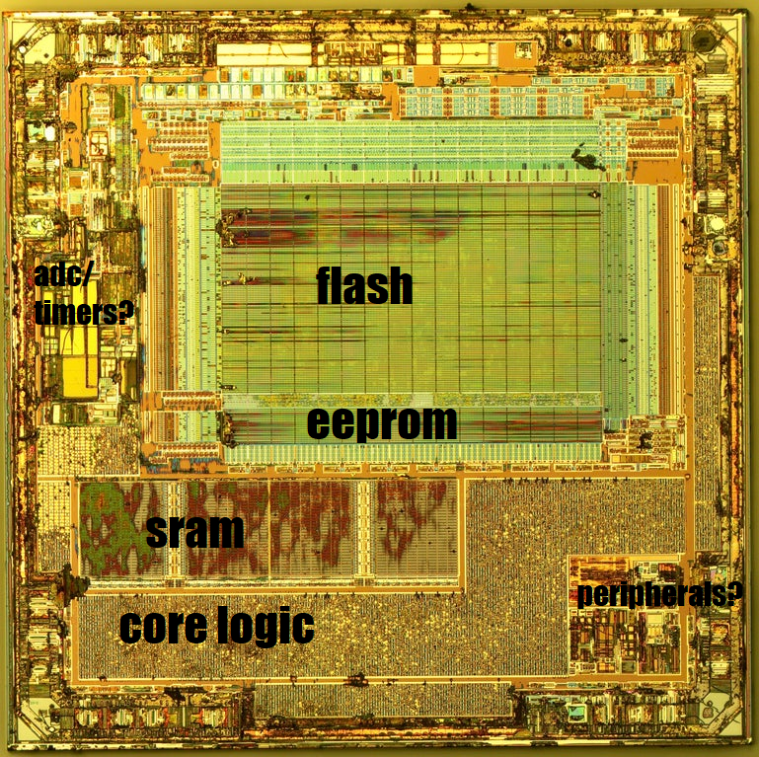
Memory management
SRAM Management
SRAM is used for runtime data, including global and local variables, stacks, and buffers.
Minimize global variables to reduce memory overhead.
Use stack-efficient coding practices, such as reusing local variables.
Avoid dynamic memory allocation (malloc/free) unless necessary, as it can lead to fragmentation.
Leverage data packing techniques, like using smaller data types or bit-fields.
Use static code analysis tools to detect potential SRAM overflows.

Slide 28
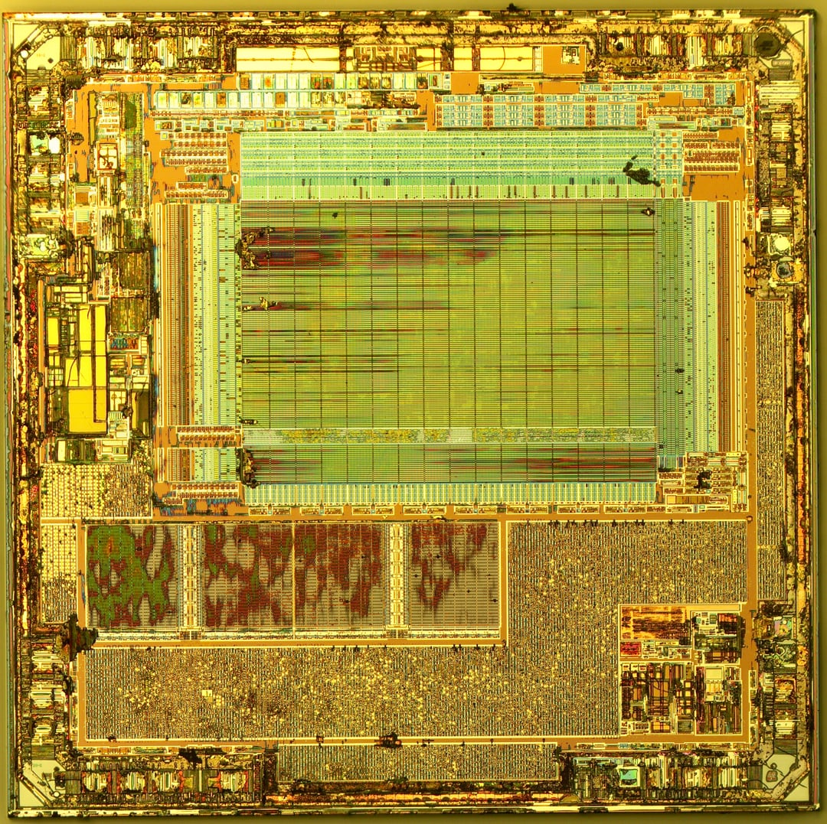
Memory management
EEPROM Management
EEPROM provides non-volatile storage for configuration or data that must persist after a reset or power loss.
Use the EEPROM library functions (eeprom_read_byte, eeprom_write_byte) for safe access.
Implement wear leveling to extend EEPROM lifespan.
Store frequently updated data in RAM and write it to EEPROM periodically.
Perform read-after-write operations to ensure data integrity.
Avoid writing to EEPROM in performance-critical sections due to slow write speeds.

Slide 29
AVR Interrupt Handling
Interrupt Vs Polling
Whenever any device need the microcontroller, the device notifies it by sending an interrupt signal.
Microcontroller continuously monitors the status of the device in polling method. When status is met, it performs the service.
We can assign priority to different interrupt differently.
The polling methods checks all devices in a round robin fashion.
Interrupt method can mask a device request for service.
Polling method wastes much of microcontroller‘s time by polling devices that do not need service.

Slide 30
AVR Interrupt Handling
Steps in executing an interrupt
It finishes the instruction it is currently executing and saves the address of the
next instruction (program counter) on the stack.
It jumps to a fixed location in memory called the interrupt vector table. The
interrupt vector table directs the microcontroller to the address of the interrupt
service routine (ISR).
The microcontroller starts to execute the interrupt service subroutine until it
reaches the last instruction of the subroutine, which is RETI (return from interrupt).
Upon executing the RETI instruction, the microcontroller returns to the place
where it was interrupted. First, it gets the program counter (PC) address from
the stack by popping the top bytes of the stack into the PC. Then it starts to
execute from that address.

Slide 31
AVR Interrupt Handling
Sources of interrupts
There are at least two interrupts set aside for each of the timers, one for overflow and another for compare match.
Three interrupts are set aside for external hardware interrupts. INT0, INT1 and INT2.
Serial communication’s USART has three interrupts, one for receive and two interrupts for transmit.
The SPI interrupts.
The ADC.

Slide 32
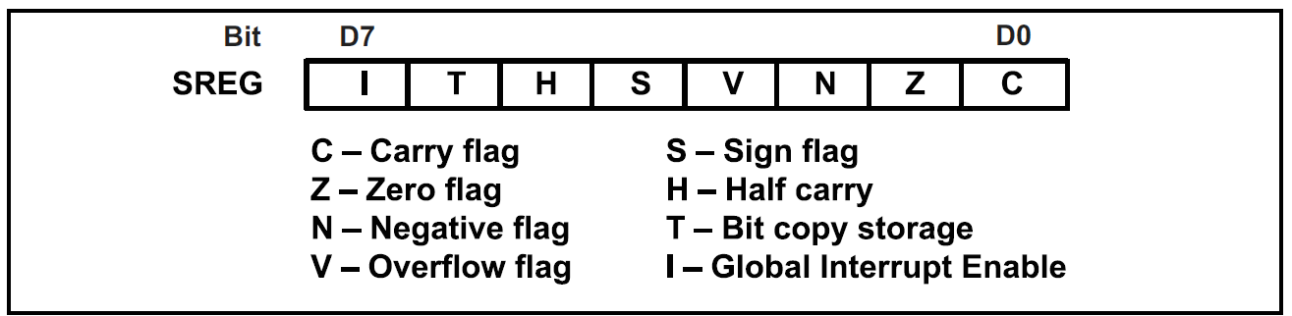
AVR Interrupt Handling
Bits of Status Register (SREG)
Bit D7 (I) of the SREG register must be set to HIGH to allow the interrupt to happen.
If I=1, each interrupt is enabled by setting to HIGH the interrupt enable flag bit for that interrupt.

Slide 33
Input and Output ports interfacing on AVR
I/O Port Registers
DDRx: Data Direction Registers
These are 8-bit registers.
These are used to configure the pins of the ports as input or output.
Writing a one to the bits in this register sets those specific pins as output pins.
Writing a zero to the bits in this register sets those specific pins as input pins.
All bits in these registers can be read as well as written to.
The initial value of these bits is zero.

Slide 34
Input and Output ports interfacing on AVR
I/O Port Registers
PORTx: Data Registers
These are 8-bit registers.
These are used to put the pins of the ports in a logic HIGH or logic LOW state.
Writing a one to the bits in this register puts a HIGH logic (5V) on those pins.
Whereas writing a zero to the bits in this register puts a LOW logic (0V) on those pins.
All bits in these registers can be read as well as written to.
The initial value of these bits is zero.

Slide 35
Input and Output ports interfacing on AVR
I/O Port Registers
PINx: Input Pins Address Registers
These are 8-bit registers.
These are used to read the values on the specific pins of the port.
These bits are read-only bits and cannot be written to.

Slide 36
Input and Output ports interfacing on AVR
//Seven segment display
#include <avr/io.h>
#include <util/delay.h>
uint8_t digits[10] = {0x3f,0x06,0x5b,0x4f,0x66,0x6d,0x7d,0x07,0x7f,0x6f};
int main(void) {
DDRD = 0xFF;
while (1) {
for (uint8_t i = 0; i < 10; i++) {
PORTD = digits[i];
_delay_ms(1000);
}
}
}

Slide 37
Input and Output ports interfacing on AVR
Create a program that reads an 8-bit value from PORTA and performs:
Extract bits 2-5 and display on PORTB
Count number of set bits in PORTA and show on PORTC (0-8)

Slide 38
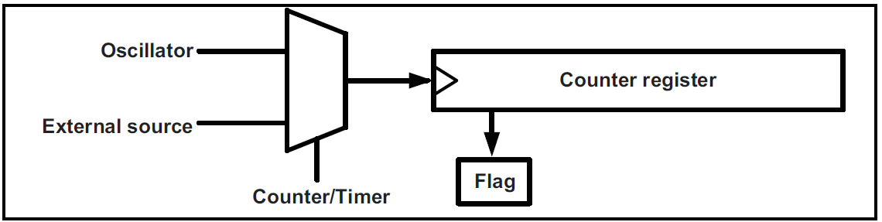
Timer and Counter in AVR
General view of Counters and Timers
When we want to count an event, we connect the external event source to the clock pin of the counter register.
When we want to generate time delays, we connect the oscillator to the clock pin of the counter.

Slide 39
Timer and Counter in AVR
Ways to generate time delays
Clear the counter at the start time and wait until the counter reaches a certain number.
Load the counter register and wait until the counter overflows and the flag is set.

Slide 40
Timer and Counter in AVR
The AVR has one to six timers/counters named as Timers 0, 1, 2, 3, 4 and 5 depending on the family member.
In AVR some of the timers/counters are 8-bit and some are 16-bit.
ATmega32, there are three timers: Timer0(8-bit), Timer1(16-bit) and Timer2(8-bit).
Every timer needs a clock pulse to tick. The clock source can be internal(for timers) or external(for counters).

Slide 41
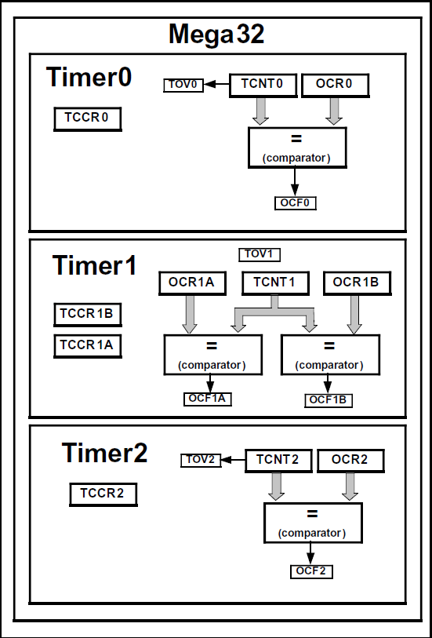
Timer and Counter in AVR
TCNTn: Timer/Counter Register
TOVn: Timer Overflow
TCCRn: Timer/Counter control register
OCRn: Output Compare Register
OCFn: Output Compare Flag

Slide 42
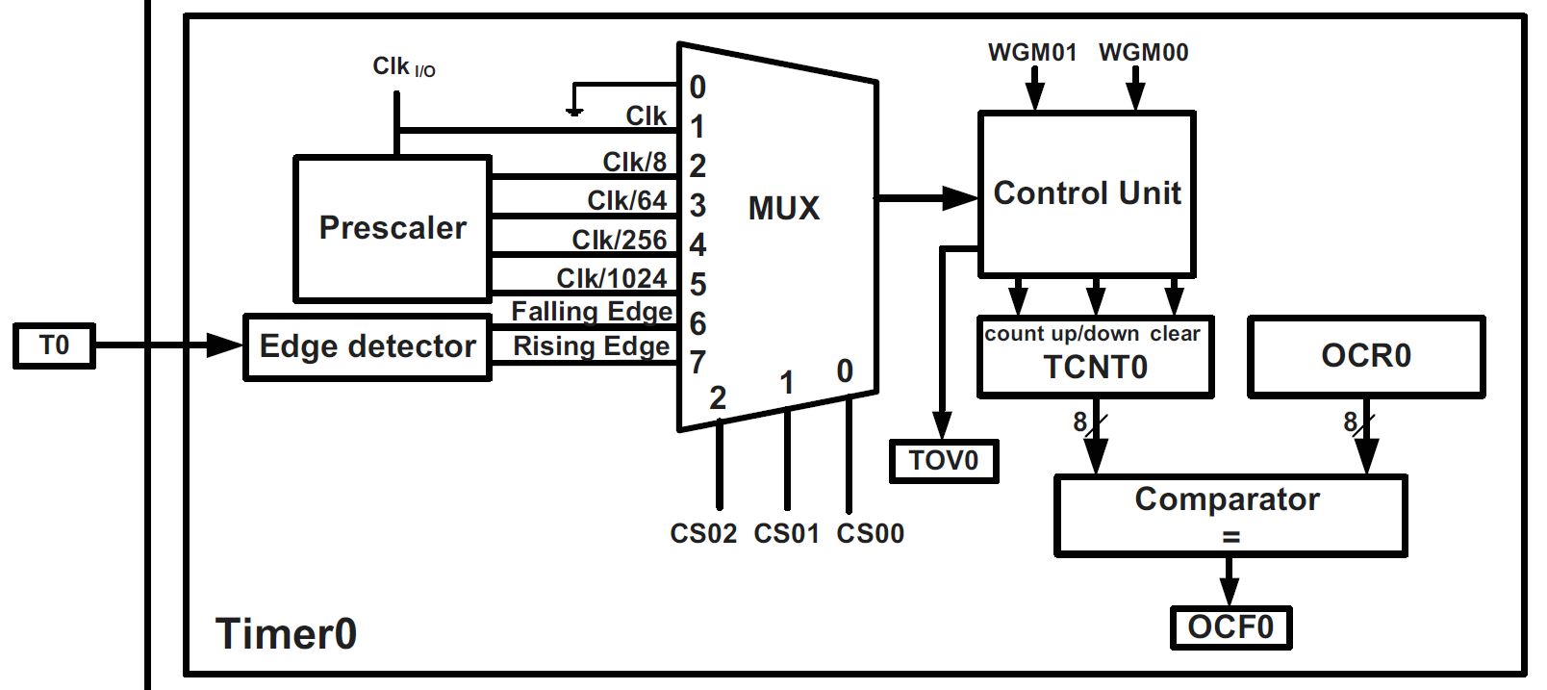
Timer and Counter in AVR
Timer0 programming
TCNTn: Timer/Counter Register
TOVn: Timer Overflow
TCCRn: Timer/Counter control register
OCRn: Output Compare Register
OCFn: Output Compare Flag

Slide 43
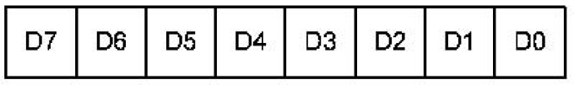
Timer and Counter in AVR
Timer0 programming
TCNT0: Timer/Counter Register0 is 8-bit register
TCCR0: Timer/Counter Control Register
FOC0: Force compare match: This is a write-only bit, which can be used while generating a wave. Writing 1 to it causes the wave generator to act as if a compare match had occurred.

Slide 44
Timer and Counter in AVR
Timer0 programming
WGM00, WGM01
WGM00 | WGM01 | Timer0 mode selector bits
0 | 0 | Normal
0 | 1 | CTC (Clear Timer on Compare Match)
1 | 0 | PWM, Phase correct
1 | 1 | Fast PWM
COM01:00 Compare Output Mode: These bits control the waveform generator.

Slide 45
Timer and Counter in AVR
Timer0 programming
CS02:00
D2 | D1 | D0 | Timer0 Clock Selector
0 | 0 | 0 | No Clock Source
0 | 0 | 1 | Clk (No Prescaling)
0 | 1 | 0 | Clk/8
0 | 1 | 1 | Clk/64
1 | 0 | 0 | Clk/256
1 | 0 | 1 | Clk/1024
1 | 1 | 0 | External clock source on T0 pin. Clock on falling edge.
1 | 1 | 1 | External clock source on T0 pin. Clock on rising edge.

Slide 46
Timer and Counter in AVR
Timer0 programming
TIFR: Timer/Counter Interrupt Flag Register
TOV0: Timer0 overflow flag bit
0 = Timer0 did not overflow
1 = Timer0 has overflowed (from $FF to $00)
OCF0: Timer0 output compare flag bit
0 = compare match did not occur
1 = compare match occurred
Note: In AVR, when we want to clear a given flag of register, we write 1 to it and 0 to the other bits.

Slide 47
Timer and Counter in AVR
Timer0 Normal Mode Programming
STEP1: Load the TCNT0 register with the initial count value.
STEP2: Load the value into the TCCR0 register for required control setting.
STEP3: Keep monitoring the timer overflow flag (TOV0). Get out of the loop when TOV0 becomes high.
STEP4: Stop the timer by disconnecting the clock source.
STEP5: Clear the TOV0 flag for the next round.

Slide 48
Timer and Counter in AVR
#include <avr/io.h>
void T0delay();
int main(void)
{
DDRB = 0xFF; /* PORTB as output*/
while(1) /* Repeat forever*/
{
PORTB=0x55;
T0delay(); /* Give some delay */
PORTB=0xAA;
T0delay();
}
}
void T0delay()
{
TCNT0 = 0x25; /* STEP1:Load TCNT0*/
TCCR0 = 0x01; /*STEP2: Timer0, normal mode, no pre-scalar */
while((TIFR&0x01)==0); /* STEP3: Wait for TOV0 to roll over */
TCCR0 = 0; /* STEP4: Disconnect clock source*/
TIFR = 0x01; /* STEP5: Clear TOV0 flag*/
}

Slide 49
Timer and Counter in AVR
Timer0 CTC Mode Programming
COM01, COM00
COM01 | COM00 | Description
0 | 0 | The normal port operation
0 | 1 | Toggle OC0 on compare match
1 | 0 | Clear OC0 on compare match
1 | 1 | Set OC0 on compare match

Slide 50
Timer and Counter in AVR
Timer0 CTC Mode Programming
STEP1: Configure OC0 pin (PB3) as output.
STEP2: Load the value into the TCCR0 register for required control setting.
STEP3: Load the required value in OCR0.

Slide 51
Timer and Counter in AVR
Normal mode waveform generation program
#include "avr/io.h"
int main ( )
{
DDRB = DDRB|(1<<3); /* PB3 (OC0) as output */
TCCR0 = 0x19; /* CTC mode, toggle on compare match,
clk- no pre-scaling */
OCR0 = 200; /* compare value */
while (1);
}

Slide 52
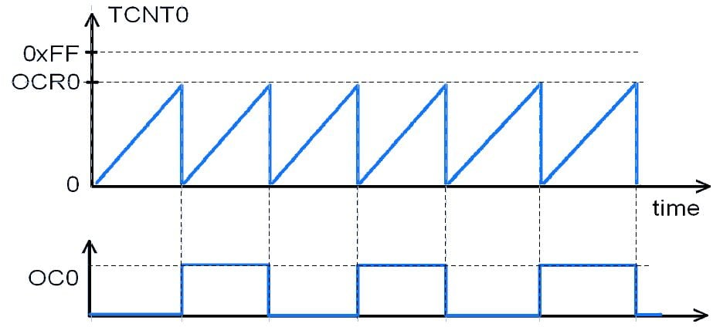
Timer and Counter in AVR
CTC mode waveform generation program

Slide 53
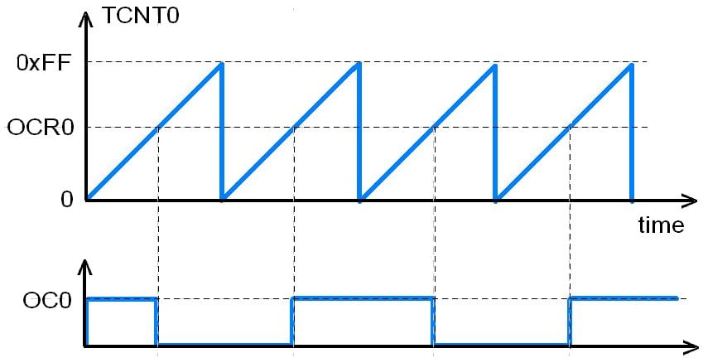
Timer and Counter in AVR
Normal mode waveform generation program

Slide 54
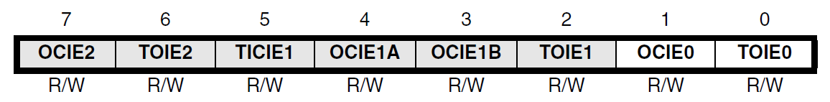
Timer and Counter in AVR
TIMSK (Timer/Counter Interrupt Mask Register)
OCIE0: (Timer/Counter0 Output Compare Match Interrupt Enable) It enables compare match interrupt is enabled. The controller jumps to the timer0 interrupt routine, if a compare match in Timer/Counter0 occurs.
TOIE0: (Timer0 Overflow Interrupt Enable) This bit is set to set the timer0 interrupt so that as soon as the Timer0 overflows, the controller jumps to the Timer0 interrupt routine.

Slide 55
Timer and Counter in AVR
#include <avr/io.h>
#include <avr/interrupt.h>
#define TCNT0_PRELOAD_VALUE 0xB2
ISR(TIMER0_OVF_vect) {
TCNT0=TCNT0_PRELOAD_VALUE;
PORTB ^= (1 << PB0);
}
void T0_init() {
DDRB |= (1 << PB0);
TCNT0 = TCNT0_PRELOAD_VALUE;
TCCR0 |= (1 << CS02) | (1 << CS00);
TIMSK |= (1 << TOIE0);
sei();
}
int main(void) {
T0_init();
while (1);
}

Slide 56
Timer and Counter in AVR
#include <avr/io.h>
#include <avr/interrupt.h>
ISR(TIMER0_COMP_vect) {
PORTB ^= (1 << PB0);
}
void T0_init() {
DDRB |= (1 << PB0);
OCR = 0x4D;
TCCR0 |= (1<<WGM01)| (1 << CS02) | (1 << CS00);
TIMSK |= (1 << OCIE0);
sei();
}
int main(void) {
T0_init();
while (1);
}

Slide 57
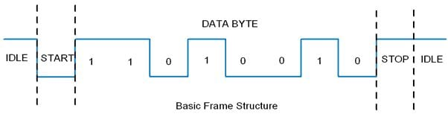
Serial Communication in AVR (USART)
While sending/receiving data, some bits are added for the purpose of knowing the beginning/ending of data.
Baud rate is number of symbols per second. Here, one symbol carries one bit information, so baud rate equals to bit rate.

Slide 58
Serial Communication in AVR (USART)
There are also other supported frame formats available in USART, like parity bit, variable data bits (5-9 data bits).
AVR Atmega USART has a TTL voltage level which is 0V for logic 0 and 5V for logic 1.

Slide 59
Serial Communication in AVR (USART)
UDR: USART Data Register
It has basically two registers, one is Tx byte and the other is Rx byte. Both share the same UDR register. When we write to the UDR reg. Tx buffer will get written and when we read from this register, Rx buffer will get read. Buffer uses the FIFO shift register to transmit the data.
UCSRA: USART Control and Status Register A.
UCSRB: USART Control and Status Register B.
UCSRC: USART Control and Status Register C.
UBRR: USART Baud Rate Register, this is a 16-bit register used for the setting baud rate.

Slide 60
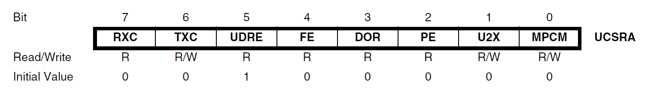
Serial Communication in AVR
UCSRA: USART control and status register A
RXC (USART Receive Complete) : This flag bit is set when there is unread data in UDR. The RXC flag can be used to generate a receive complete interrupt.
TXC (USART Transmit Complete) This flag bit is set when the entire frame from Tx Buffer is shifted out and there is no new data currently present in the transmit buffer (UDR).

Slide 61
Serial Communication in AVR
UCSRA: USART control and status register A
UDRE (USART Data register Empty): If UDRE is one, the buffer is empty which indicates the transmit buffer (UDR) is ready to receive new data.
U2X: Double the USART transmission Speed

Slide 62
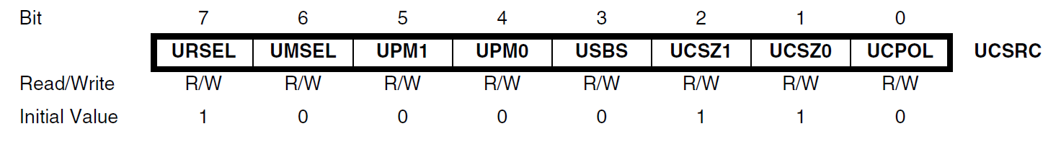
Serial Communication in AVR
UCSRC: USART control and status register C
URSEL (USART Register Select) : This bit selects between accessing the UCSRC or the UBRRH register. It is read as one when reading UCSRC. The URSEL must be one when writing the UCSRC.
UMSEL (USART mode select): This bit select between Asynchronous and Synchronous mode of operation. 0 for Asynchronous
UPM1-UPM0 (USART Parity Mode) 00 for disabled, 10 for even parity and 11 for odd parity.

Slide 63
Serial Communication in AVR
UCSRC: USART control and status register C
USBS (USART Stop Bit Select) : 0 for 1-stop bit and 1 for 2-stop bit.
UCSZ2,UCSZ1,UCSZ0 (USART Character Size): 000 for 5-bits, 001 for 6-bits, 010 for 7-bits, 011 for 8-bits and 111 for 9-bits.

Slide 64
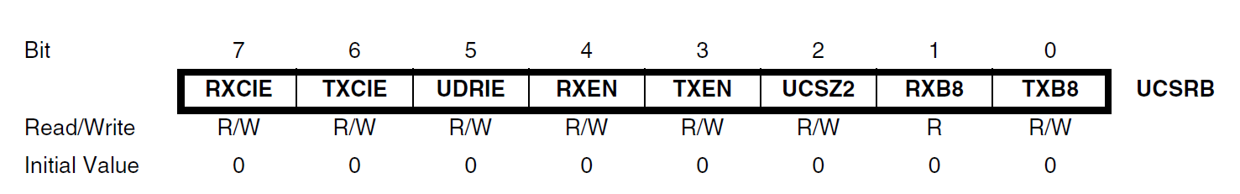
Serial Communication in AVR
UCSRB: USART control and status register B
RXEN (Receiver Enable) : Writing this bit to one enables the USART Receiver.
TXEN (Transmitter Enable): Writing this bit one enables the USART transmitter.
RXB8 (Receive data Bit 8): The ninth bit of the received character. Must be read before reading the low bits from UDR.
TXB8 (Transmit data Bit 8): The ninth bit in the character to be transmitted. Must be written before writing the low bits to UDR.

Slide 65
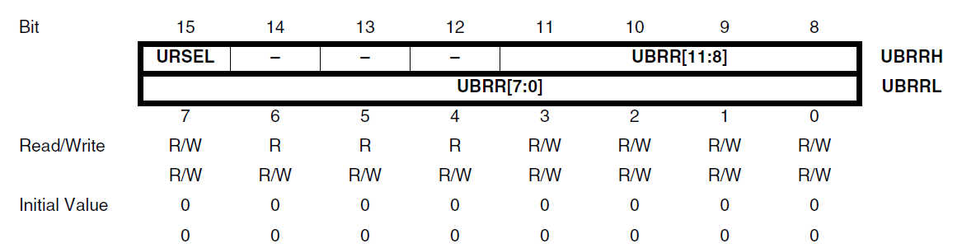
Serial Communication in AVR
UBRR: USART Baud Rate Register
URSEL (USART Register Select): The URSEL must be zero when writing the UBRRH.
UBRR11:0 (USART Baud Rate Register): The ninth bit in the character to be transmitted. Must be written before writing the low bits to UDR.

Slide 66
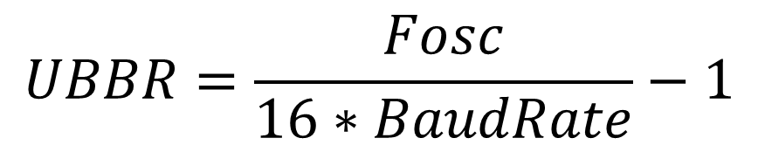
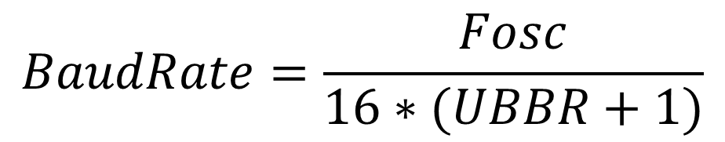
Serial Communication in AVR
UBRR: USART Baud Rate Register
$$UBBR=\frac{Fosc}{16∗BaudRate}−1$$
$$BaudRate=\frac{Fosc}{16∗(UBBR+1)}$$

Slide 67
Serial Communication in AVR
What must be the value of UBRR to achieve baud rate of 9600 baud if clock frequency is 8 MHz?
What if U2X is 1?
$$UBBR=\frac{Fosc}{16∗BaudRate}−1$$
$$BaudRate=\frac{Fosc}{16∗(UBBR+1)}$$

Slide 68
Serial Communication in AVR
#define F_CPU 8000000UL
#include <avr/io.h>
#include <util/delay.h>
#include <stdlib.h>
#include <stdio.h>
#define BAUD_PRESCALE (((F_CPU / (USART_BAUDRATE * 16UL))) - 1)
void UART_init(long USART_BAUDRATE)
{
UCSRB |= (1 << RXEN) | (1 << TXEN);/* Turn on transmission and reception */
UCSRC |= (1 << URSEL) | (1 << UCSZ0) | (1 << UCSZ1);/* Use 8-bit character sizes */
UBRRL = BAUD_PRESCALE; /* Load lower 8-bits of the baud rate value */
UBRRH = (BAUD_PRESCALE >> 8); /* Load upper 8-bits*/
}
unsigned char UART_RxChar()
{
while ((UCSRA & (1 << RXC)) == 0);/* Wait till data is received */
return(UDR); /* Return the byte*/
}

Slide 69
Serial Communication in AVR
void UART_TxChar(char ch)
{
while (! (UCSRA & (1<<UDRE))); /* Wait for empty transmit buffer*/
UDR = ch ;
}
void UART_SendString(char *str)
{
unsigned char j=0;
while (str[j]!=0) /* Send string till null */
{
UART_TxChar(str[j]);
j++;
} }
int main()
{
char c;
UART_init(9600);
UART_SendString("\n\t Echo Test ");
while(1)
{
c=UART_RxChar();
UART_TxChar(c);
} }

Slide 70
Syllabus of Embedded System
Unit 2: Programming for Embedded Systems (5 Hours)
2.1 Overview of AVR Architecture
2.2 Embedded C Programming for Microcontroller
Introduction to C for Embedded Systems
Data Types, Control Structures, and pointers
Memory Management
AVR Interrupt handling
Input and output ports interfacing on AVR
Timers and Counters in AVR
Serial Communication in AVR

Slide 71
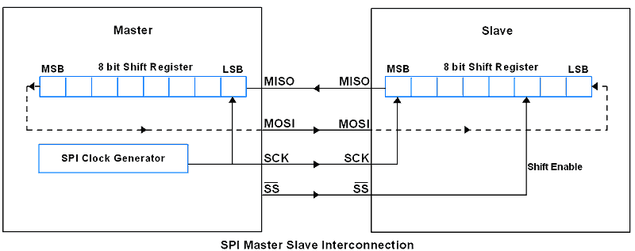
Serial Communication in AVR (SPI)
The Serial Peripheral Interface SPI is a bus interface connection protocol.
It uses four pins for communication:
SDI (Serial Data Input) / MISO (Master In Slave Out)
SDO (Serial Data Output) / MOSI (Master Out Slave In)
SCLK (Serial Clock) / SCK (Shift Clock)
CS (Chip Select) / SS (Slave Select)

Slide 72
Serial Communication in AVR (SPI)
Three registers to configure SPI communication that are SPI Control Register, SPI Status Register and SPI Data Register.
SPCR : SPI Control Register
7 | 6 | 5 | 4 | 3 | 2 | 1 | 0
SPIE | SPE | DORD | MSTR | CPOL | CPHA | SPR1 | SPR0
SPIE : SPI Interrupt Enable bit (1 for enabling interrupt)
SPE : SPI Enable bit (1 for enabling SPI)
DORD : Data Order bit (1 for LSB transmitted first and 0 for MSB)
MSTR : Master/Slave Select bit (1 for Master mode and 0 for slave mode

Slide 73
Serial Communication in AVR (SPI)
Three registers to configure SPI communication that are SPI Control Register, SPI Status Register and SPI Data Register.
SPCR : SPI Control Register
7 | 6 | 5 | 4 | 3 | 2 | 1 | 0
SPIE | SPE | DORD | MSTR | CPOL | CPHA | SPR1 | SPR0
CPOL : Clock Polarity Select bit (1 for clock start from logical 1 and 0 for clock start from logical 0.
CPHA : Clock Phase Select bit (1 for data sample on trailing clock edge and 0 for data sample on leading clock edge)

Slide 74
Serial Communication in AVR (SPI)
Three registers to configure SPI communication that are SPI Control Register, SPI Status Register and SPI Data Register.
SPCR : SPI Control Register
7 | 6 | 5 | 4 | 3 | 2 | 1 | 0
SPIE | SPE | DORD | MSTR | CPOL | CPHA | SPR1 | SPR0
SPR1: SPR0 : SPI Clock Rate Select bits
00 for Fosc/4
01 for Fosc/16
10 for Fosc/64
11 for Fosc/128

Slide 75
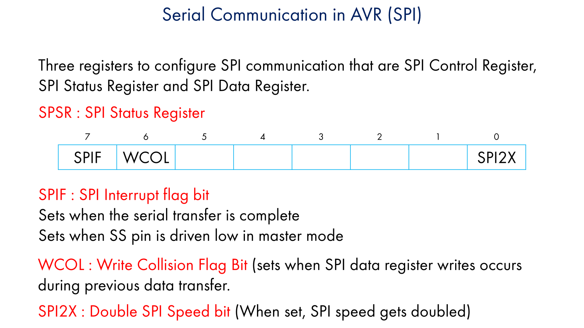

Slide 76
Serial Communication in AVR (SPI)
Three registers to configure SPI communication that are SPI Control Register, SPI Status Register and SPI Data Register.
SPDR : SPI Data Register
7 | 6 | 5 | 4 | 3 | 2 | 1 | 0

Slide 77
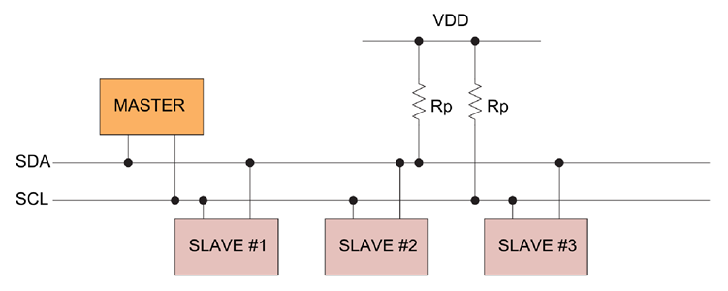
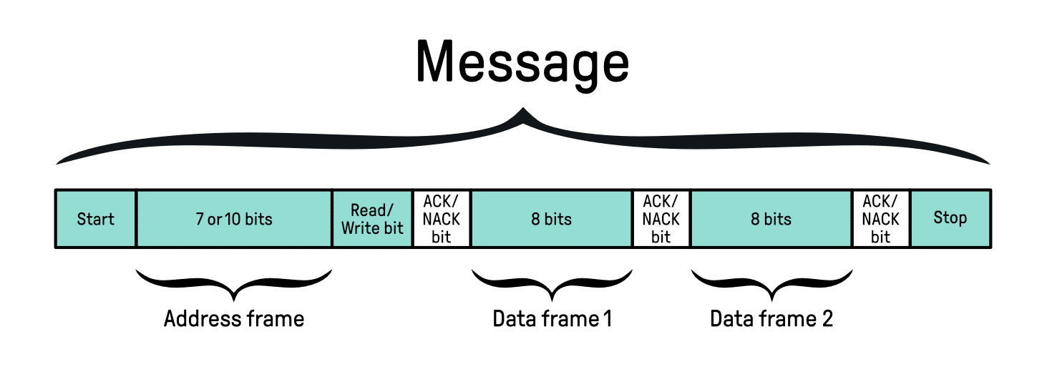
Serial Communication in AVR (I2C)

Slide 78
Serial Communication in AVR (I2C)
The control unit contains TWSR (TWI status register), TWCR (TWI Control Register).
TWCR : TWI Control Register
7 | 6 | 5 | 4 | 3 | 2 | 1 | 0
TWINT | TWEA | TWSTA | TWSTO | TWWC | TWEN | - | TWIE
TWINT : TWI Interrupt (This bit gets set whenever TWI completes its current event)
TWEA : TWI Enable acknowledgement bit (It is set in receiver mode to generate acknowledgement and cleared in transmit mode.)
TWSTA : TWI Start bit condition(The master device set this bit to generate START condition by monitoring free bus status to take control over the TWI bus.)

Slide 79
Serial Communication in AVR (I2C)
The control unit contains TWSR (TWI status register), TWCR (TWI Control Register).
TWCR : TWI Control Register
7 | 6 | 5 | 4 | 3 | 2 | 1 | 0
TWINT | TWEA | TWSTA | TWSTO | TWWC | TWEN | - | TWIE
TWSTO : TWI Stop bit condition(The master device set this bit to generate Stop condition to leave control over the TWI bus.)
TWWC : TWI Write collision (This bit gets set when writing to the TWDR register before the current transmission not complete.)
TWEN : TWI Enable bit (This bit set to enables the TWI interface in the device and takes control over the I/O pins.)
TWIE : TWI interrupt enable (Used to enable TWI to interrupt routine.)

Slide 80
Serial Communication in AVR (I2C)
The control unit contains TWSR (TWI status register), TWCR (TWI Control Register).
TWSR : TWI Status Register
7 | 6 | 5 | 4 | 3 | 2 | 1 | 0
TWS7 | TWS6 | TWS5 | TWS4 | TWS3 | - | TWPS1 | TWPS0
TWS7 : TWS3 TWI status bits (TWI status bits shows the status of TWI control and bus.)
TWPS1:TWPS0 (TWI pre-scaler bits used in bit rate formula)
TWPS1 | TWPS0 | Exponent | Pre-scaler value
0 | 0 | 0 | 1
0 | 1 | 1 | 4
1 | 0 | 2 | 16
1 | 1 | 3 | 64

Slide 81
Serial Communication in AVR (I2C)
TWAR : TWI Address Register
7 | 6 | 5 | 4 | 3 | 2 | 1 | 0
TWA6 | TWA5 | TWA4 | TWA3 | TWA2 | TWA1 | TWA0 | TWGCE
TWA6 : TWA0 TWI Address bits (TWI 7-bit address with which it can be called by other masters in slave mode.)
TWGCE (TWI general call enable bit)

Slide 82
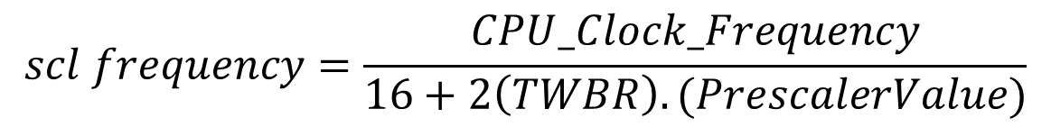
Serial Communication in AVR (I2C)
TWBR : TWI Bit Rate Register
7 | 6 | 5 | 4 | 3 | 2 | 1 | 0
TWBR7 | TWBR6 | TWBR5 | TWBR4 | TWBR3 | TWBR2 | TWBR1 | TWBR0
$$scl frequency=\frac{CPU_Clock_Frequency}{16+2\left(TWBR\right).(PrescalerValue)}$$

Slide 83
Serial Communication in AVR (I2C)
TWDR : TWI Data Register
7 | 6 | 5 | 4 | 3 | 2 | 1 | 0

